Slide 1
FPS Local Pension Board (LPB) Refresher Training
The Bluelight Team
Date
www.local.gov.uk

Slide 2
Agenda
Welcome and Introductions
Group Discussion
Age Discrimination Remedy
Governance and Management Stakeholders
Six key principles

Slide 3
Introductions
Bluelight team
Claire Johnson (maternity leave)
Senior Firefighters’ Pension Adviser
Tara Atkins
Firefighters’ Pension Adviser
Sandra Sedgwick
Firefighters’ Pension Adviser
Bluelightpensions@local.gov.uk

Slide 4
Who are we?
LGA is a politically-led, cross-party organisation that works on behalf of councils to ensure local government has a strong, credible voice with national government.
The pensions team sits alongside our workforce colleagues to work with public sector bodies to manage their workforce and pensions, and our particular role is to work with the Fire and Rescue representing employers’ interests to central government and other bodies on Firefighters Pensions policy.

Slide 5
An important note
These slides are intended to provide an overview of the scheme regulations and should not be regarded as a complete guide
Please note that it is the responsibility of each FRA to apply the rules of the pension scheme in accordance with their interpretation of the scheme and to obtain legal advice where they consider this is necessary.
The information contained in these slides have been provided to give some guidance on the rules of the pension scheme, however they should be used only as an informal view of the interpretation of the firefighters' pension scheme as only a Court can provide a definitive interpretation of legislation.

Slide 6
The Bluelight Team
DO:
DO NOT:
Advise
Guide
Help
Steer
Police
Inspect
Regulate
Report
Whistle blow
Do it for you

Slide 7
Administration and management
Each of the 43 England Fire & Rescue Authorities are responsible for the management and administration of the scheme and are defined in law as the scheme manager
This responsibility is managed differently within each FRA depending on governance.
Each FRA is required to administer and manage the scheme
Currently 11 different pension administrators across the 43 FRAs, a list of Authorities and their administrators can be found here.
Notes:
Each of the 45 Fire and Rescue Authorities (FRAs) are responsible for the management and administration of their scheme and are defined in law as the scheme manager - Responsibility to comply with over-riding pension legislation is on each FRA.
At present this responsibility is managed differently within each FRA, this can depend on whether they are a combined authority or whether the FRA function sits within a county council.
Each FRA is required to administer the pension scheme either in-house or appoint a third party administrator. There are currently 20 different pension administrators across the 45 FRAs, a list of Authorities and their administrators can be found here.

Slide 8
Now it is over to you?

Slide 9
Please introduce yourself ….
Name
Which LPB do you represent?
What’s your role on the LPB? i.e. member rep, employer rep, etc.
How long have you been on the LPB?

Slide 10
What do you think is most challenging for board members?
How are you assisting your scheme manager in the management of the pension scheme?
Please enter comments in the chat or put your virtual hand up!
End

Slide 11
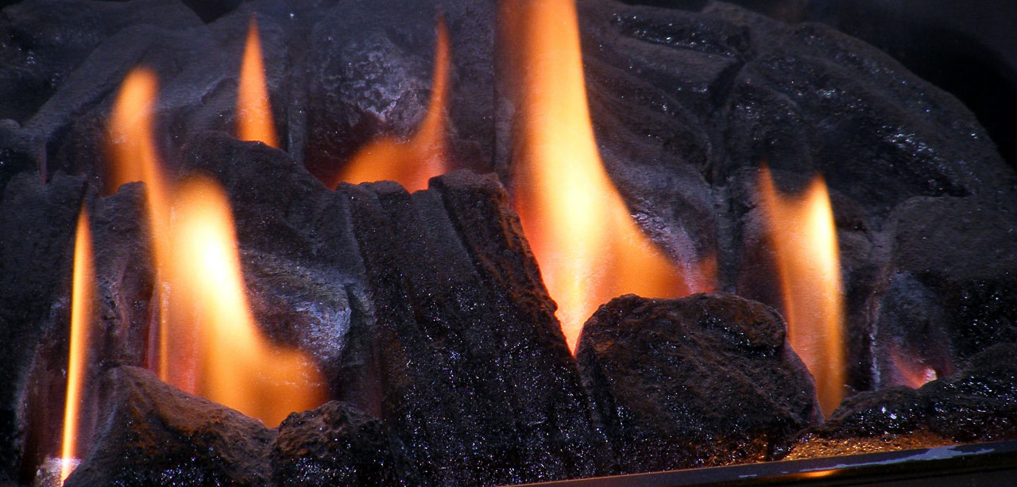
Current Hot Topics

Slide 13
Two major projects
Sargeant
Matthews

Slide 14
Central support
Remedy readiness self-assessment tool
Remedy readiness tool is available on the Regulations and Guidance website.
Scheme managers/Pension Boards can reflect on own readiness for remedy.
FPS Websites
Identifies potential gaps which need addressing.
FPS Regulations and guidance website
Specific section on the age discrimination remedy
FPS Member website
Specific section on the age discrimination remedy
Member FAQs
LGA Communications
Monthly bulletins
Regular ‘coffee mornings’
Bank of supporting documentation aimed at scheme managers and administrators

Slide 15
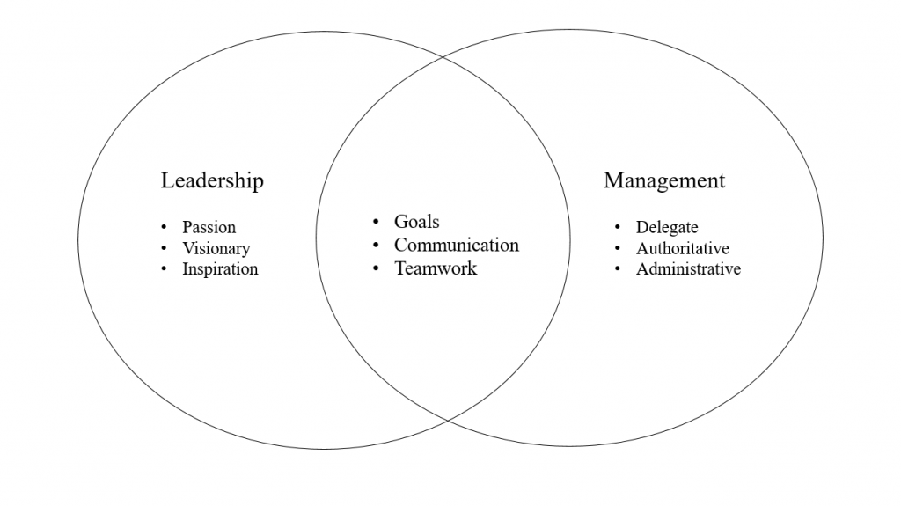
FPS Governance and Management stakeholders
End

Slide 16
We’ve got a factsheet for that:
FPS management and governance factsheet

Slide 17
Roles and responsibilities
Scheme manager (employer)
Local Pension Boards
Scheme Advisory Board
Administrator (third party or in-house)
LGA
Home Office (responsible authority)
The Pensions Regulator
This Photo by Unknown Author is licensed under CC BY-SA-NC

Slide 18
Scheme manager
Defined in law as the Fire & Rescue Authority [Rule 4]
Responsible for managing and administering the FPS 2015 and any connected scheme (i.e. FPS 1992, FPS 2006 and Special FPS 2006)
Provision to delegate under the regulations [Rule 5]
Delegated scheme manager should sit within the senior management team
Scheme manager factsheet
Notes:
If PFCC or mayoral, the commissioner or mayor’s office become the scheme manager
Calculation and payment of benefits
Decisions and discretions
Disclosure of information
Record keeping
Internal controls
Internal Dispute Resolution
Reporting breaches of law
Statements, reports and accounts
Delegation not abdication!
One of key problems for scheme management is 45 decision makers, making 45 different decisions, 45 times over.

Slide 19
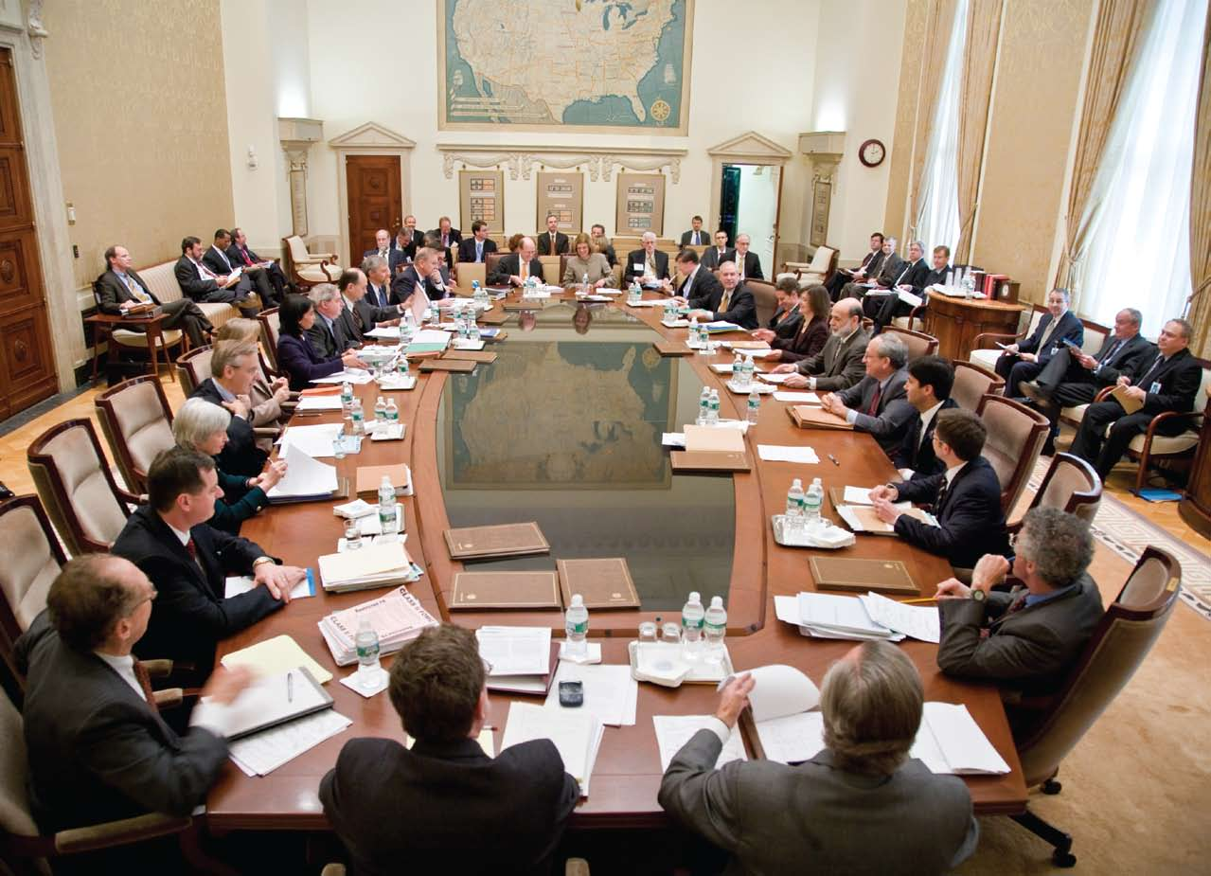
Local Pension Boards
Introduced by the Public Service Pension Act 2013 and FPS governance regulations [Rule 4A to 4D]…
… to assist the scheme manager to secure compliance with the regulations, any other legislation relating to the governance and administration of the scheme, and any requirements imposed by TPR in relation to the scheme.
The board also assists the scheme manager to ensure the effective and efficient governance and administration of the scheme.

Slide 20
Scheme Advisory Board
Introduced by the Public Service Pension Act 2013 and FPS governance regulations [Rule 4E to 4H]
Two main functions:
provide advice as requested by the Secretary of State on the desirability of making changes to the scheme
provide advice to the Scheme Managers and Local Pension Boards in relation to the effective and efficient administration and management of the scheme
Three committees support objectives on cost, administration, and LPB effectiveness

Slide 21
Administrator
Appointed to run day to day scheme administration
All legal responsibilities remain with the scheme manager
Typical duties include paying pensions, issuing Annual Benefit Statements, Remediable Service Statements and Pension Saving Statements
List of current scheme administrators
Notes:
In practice, SM appoints an administrator – third party or in-house. Give some details of number etc
Again, delegation not abdication

Slide 22
LGA
Provide support and guidance to employers:
Technical advice
Library of guides and sample documents
Monthly information bulletins
Training
Facilitation of regional and national forums: technical, communications, fire pension officers
Representing stakeholders interests at national level
Secretariat service for Scheme Advisory Board
Notes:
Already looked at who we are, but what do we do?

Slide 23
Home Office
The Home Office is the responsible authority for the FPS.
The Home Office is responsible for making scheme regulations and policy decisions.

Slide 24
The Pensions Regulator (TPR)
The Public Service Pension Act 2013 gave TPR regulatory oversight of public service schemes.
TPR is a public body established to make sure that pension schemes within the UK are run properly and can provide secure benefits for their members upon retirement.
TPR has powers to "educate, enable, and enforce", and is responsible for promoting robust scheme governance.

Slide 25
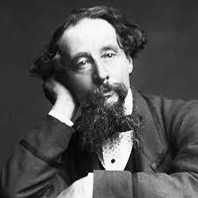
Great expectations
What should we expect from each other?
Where do our interdependencies lie?

Slide 26
Scheme manager expectations
Scheme manager at the heart of good administration and management.
But what help can they expect?
LPB to
gain knowledge and understanding of scheme.
provide constructive challenge and feedback.
review processes and identify improvements.
Admin
LGA
Scheme Manager
Pension Board
Scheme Advisory Board

Slide 27
Scheme manager expectations - continued
Expectations of the administrator will be formally set out in a Service Level Agreement and should be frequently monitored.
The scheme manager cannot expect the administrator to make decisions about local issues e.g. pensionable pay.
Planned template administration strategy will help formalise expectations between parties.
The LGA to provide appropriate advice, guidance, and training to assist the scheme manager in fulfilling their role.

Slide 28
Local Pension Board expectations
Access to all information and resources needed to support the scheme manager.
Scheme manager to attend LPB meetings and advise members of any issues arising.
Board is adequately resourced in terms of members and length of office.
The LGA to provide appropriate advice, guidance, and training to assist the LPB in fulfilling their role.

Slide 29
Scheme Advisory Board expectations
The two expectations of the SAB are set out in legislation:
Any person/ party who is given advice by the SAB, must have regard to that advice [PSPA 2013 Sect 7(3)].
Scheme manager will pay the amount required each year under the statutory levy [Rule 4H(3)].

Slide 30
Administrator expectations
Expectations set out in SLA.
Good quality, accurate and timely data is a key expectation.
Scheme managers to comply with all statutory requirements.
Scheme manager to make decisions about the scheme e.g. local discretions and advise the administrator.
Pensions admin strategy will formalise other standards of expectation.
LGA resources and technical advice also available to administrators.

Slide 31
LGA expectations
Our only expectation is that employers and administrators are aware of, and use, the information and guidance we provide.
An extract from the Aon administration and benchmarking report commissioned by the SAB:
“Our assumption is that the Scheme would be more effectively managed and administered if support which is already available were universally used.”

Slide 32
Home Office expectations
“Please note that it is the legal responsibility of each FRA to apply the rules of the pension scheme in accordance with independent legal advice where they consider this is necessary. It is not the responsibility of the Department to give legal advice to FRAs; the Department can only give an informal view on the interpretation of the firefighters' pension scheme as only a Court can provide a definitive interpretation of legislation. FRAs should not rely directly on, or share, the Department’s informal view.”

Slide 33
TPR expectations
Schemes to comply with statutory requirements and guidance.
Including current General Code: Governance and administration of public service pension schemes.
Recording and reporting of breaches of the law.
Completion of the statutory annual scheme return.
Completion of the voluntary annual governance and administration survey.

Slide 34
The Six Key Principles

Slide 35
General Code
Governing your scheme
Knowledge and Understanding
Conflicts of Interest and Representation
Publishing Information about managing schemes
Managing Risks
Internal Controls
Administration
Scheme Record-keeping
Maintaining Contributions
Providing Information to Members
Resolving Disputes
Internal Dispute Resolution
Reporting Breaches of Law

Slide 36
Understand Risk | Informed and Knowledge-able | Understand the Data | Collect the money at the right time | What to do when something goes wrong | No Conflicts of Interest
4. Internal Controls | 1.Knowledge and Understanding | 3. Publishing information about schemes | 6. Maintaining Contributions | 9. Reporting Breaches of Law | 2. Conflicts of Interest and Representation
 | 7. Providing information to members | 5. Scheme Record Keeping
 | 8. Internal Dispute Resolution
End

Slide 37
What are the risks?

Slide 38
Who is the risk register for?
It is the Local Pension Board’s statutory responsibility to assist the scheme manager in ensuring compliance, therefore the responsibility for risk sits with the scheme manager, and it is for the board to ensure there is suitable mitigation of risk in the form of a risk register and procedures.
End

Slide 39
Risk
Regulatory and Compliance | Financial | Operational
Non compliance with TPR | Excessive Charges | Member Data
Failure to interpret regulations | Pension Fund accounting mistakes | Administrative failures
Failure to comply with disclosure requirements | Authority costs due to failure to apply scheme / tax rule correctly | Premises
Failure to communicate with scheme members | Failure to deduct correct employee contributions | Software
 | Fraud | Workforce planning
Regular
assessment?
End

Slide 40
How do you manage and recognise risk?
How does your scheme make decisions
Do you know where to get advice?
Have you asked your administrator whether they will complete year end this year?
How do you assess risk?
Key personnel
Administrator resilience
What Internal Controls are there?
Are the stakeholder relationships at the right level
End

Slide 41
Known areas of risk
Compliance | Two Pensions Scheme Sanction Charge Pensionable Pay
Cost of rectifying mistakes | From FRA Operating account Regulations do not give guidance on correcting errors Reputational
Legal Cases | Age Discrimination Retained Firefighters access to the scheme prior to July 2000
Breaches | Record vs Report
Capacity | Administrator Key person risk
End

Slide 42
To be informed and knowledgeable
This Photo by Unknown Author is licensed under CC BY-SA

Slide 43
TPR Assessment Tool
End

Slide 44
Getting where you want to be…
High support
Supporters Club
“We’re here to support the scheme manager”
Partners or critical friends
“We share everything, good or bad”
Abdicators
“We leave it to the professionals”
Adversaries
“We keep a very close eye on the staff”
Low challenge
High challenge
Low support
End

Slide 45
Useful skills for critical friends
Support
Stewardship
Strategy
Stretch
Scrutiny
Julia Unwin: The 5S’s in Governance

Slide 46
Support
To encourage, a critical friend asks;
Have you got what you need to do that?
We ought to celebrate that?
Six core principles
Assess and mitigate your risks
Encourage knowledge and skills
Know your data
Collect the right money at the right time
Record and report when something goes wrong
Act without conflict

Slide 47
Stewardship
Six core principles
Assess and mitigate your risks
Encourage knowledge and skills
Know your data
Collect the right money at the right time
Record and report when something goes wrong
Act without conflict
To protect and conserve their assets; a critical friend acting to guard access to knowledge and a good name says;
How can we preserve that knowledge so that we can still learn from it in five years time?
If a resource was removed would a risk be introduced?
How would we cope if……
What do we expect

Slide 48
Strategy
Before making big decisions, critical friends listen to what others have to say, consult experts and their stakeholders, and then say;
Where could we be in five years time?
What do we want to achieve?
What are other people doing?
Where can we gain access to resource / knowledge
Six core principles
Assess and mitigate your risks
Encourage knowledge and skills
Know your data
Collect the right money at the right time
Record and report when something goes wrong
Act without conflict

Slide 49
Stretch
To challenge and improve an organisation, critical friends say;
How can we improve?
Why are we doing …
What best practice is there?
Have we thought of doing it differently?
Six core principles
Assess and mitigate your risks
Encourage knowledge and skills
Know your data
Collect the right money at the right time
Record and report when something goes wrong
Act without conflict
End

Slide 50
Scrutiny
Critical friends that are scrutinising or examining processes say;
What alternatives did you consider and why?
What regulations or case-law did you use to make your decision and why?
Have you followed guidance
What is someone else doing?
Six core principles
Assess and mitigate your risks
Encourage knowledge and skills
Know your data
Collect the right money at the right time
Record and report when something goes wrong
Act without conflict

Slide 51
Understand the data

Slide 52
Firefighter Pension Schemes
FPS 1992 | FPS 2006 (Standard Members) | FPS 2006 (Special Members) | FPS 2015 | Compensation Scheme | Remedy | Post Remedy
Protected standard members | Protected standard members | Protected special members | 2015 only | Benefits based on service | Better off Final Salary or CARE
 | Protected retained members | Special Members (Pre 2000) | 1992 transitional | Protections for retained firefighters with a qualifying injury before 1st April 2014
 |  |  | 2006 standard transitional
 |  |  | 2006 standard retained transitional
 |  |  | 2006 special transitional members
End

Slide 53
What priority do you put on data?
What processes do you have in place to improve data?
Is data as expected?
Value in measuring data
Data held securely on software
Reporting available on expected fields
Employer data such as retained firefighter employment records
Data provided on time and accurate to administrators?
Processes to ensure the administrator is aware of entitlement
Drop in Pay
Additional Pension Benefits
Do your processes work?
Do you know what should be provided (link back to knowledge?)
What are the effects
How is your score measured and reported
What is your action plan
LGA Data Scoring Guidance TPR Data Measuring Guidance

Slide 54
Accuracy Weighting
Developed guidance to measure effectiveness of processes across 4 categories
Data as expected
Consistency
Validation
Specific Processes
Weighting template

Slide 55
Data Cycle
Queries and Re-Issuing ABS
Pension Savings Statements
TPR scheme return
TPR admin and governance
September to December
VSP Tax payments
Data preparation scheme yr end
January to March
Scheme year start
ABS Preparation
Pension Incs and CARE reval
April to June
Employer data deadline
MSP deadline
ABS issue
June to August
DATA
End

Slide 56
Are you dashboard ready?
A platform to allow savers to view all their pension pots through a single portal.
Pensions Dashboard Programme (PDP) website
The Pensions Regulator (TPR) tools

Slide 57
Cost effective administration
How much does it cost to administrate and manage your scheme?
Is the management and administration effective

Slide 58
Collect the right money
at the right time!

Slide 59
Contribution Payments
FPS 2006 Special Members paying by direct debit
Contribution Holiday – FPS 1992
Employer contributions - Absence
Employer Ill-health Contributions
Remedy

Slide 60
What happens when it goes wrong

Slide 61
Reporting and recording breaches
http://www.thepensionsregulator.gov.uk/docs/PS-reporting-breaches-examples-traffic-light-framework.pdf
End

Slide 62
Breach Assessment
Breach Assessment Template
End

Slide 63
To act without conflict
This Photo by Unknown Author is licensed under CC BY-SA

Slide 64
Conflict of Interest
The scheme manager must ensure there is no conflict of interest upon appointment and manage any potential conflict of interest that may arise.
Conflict does not arise by virtue of membership of the scheme or any connected scheme but means a financial or other interest likely to prejudice the person's exercise of functions as a member of the board.

Slide 65
Conflict of Interest
Identify
Monitor
Manage

Slide 66
Remember
Assess and mitigate your risks
1
Encourage knowledge and skills
2
Know your data
3
Collect the right money at the right time
4
Record and report when something goes wrong
5
Act without conflict
6

Slide 67
Any questions

Slide 68
Disclaimer
The information contained in these slides are the authors interpretation of the current regulations.
Readers should take their own legal advice on the interpretation of any particular piece of legislation.
No responsibility whatsoever will be assumed by LGA or their partners for any direct or consequential loss, financial or otherwise, damage or inconvenience, or any other obligation or liability incurred by readers relying on information contained in these slides.

Slide 69
Thank you for listening!
Bluelight.pensions@local.gov.uk
www.fpsboard.org&www.fpsregs.org
www.local.gov.uk

